Slide 1
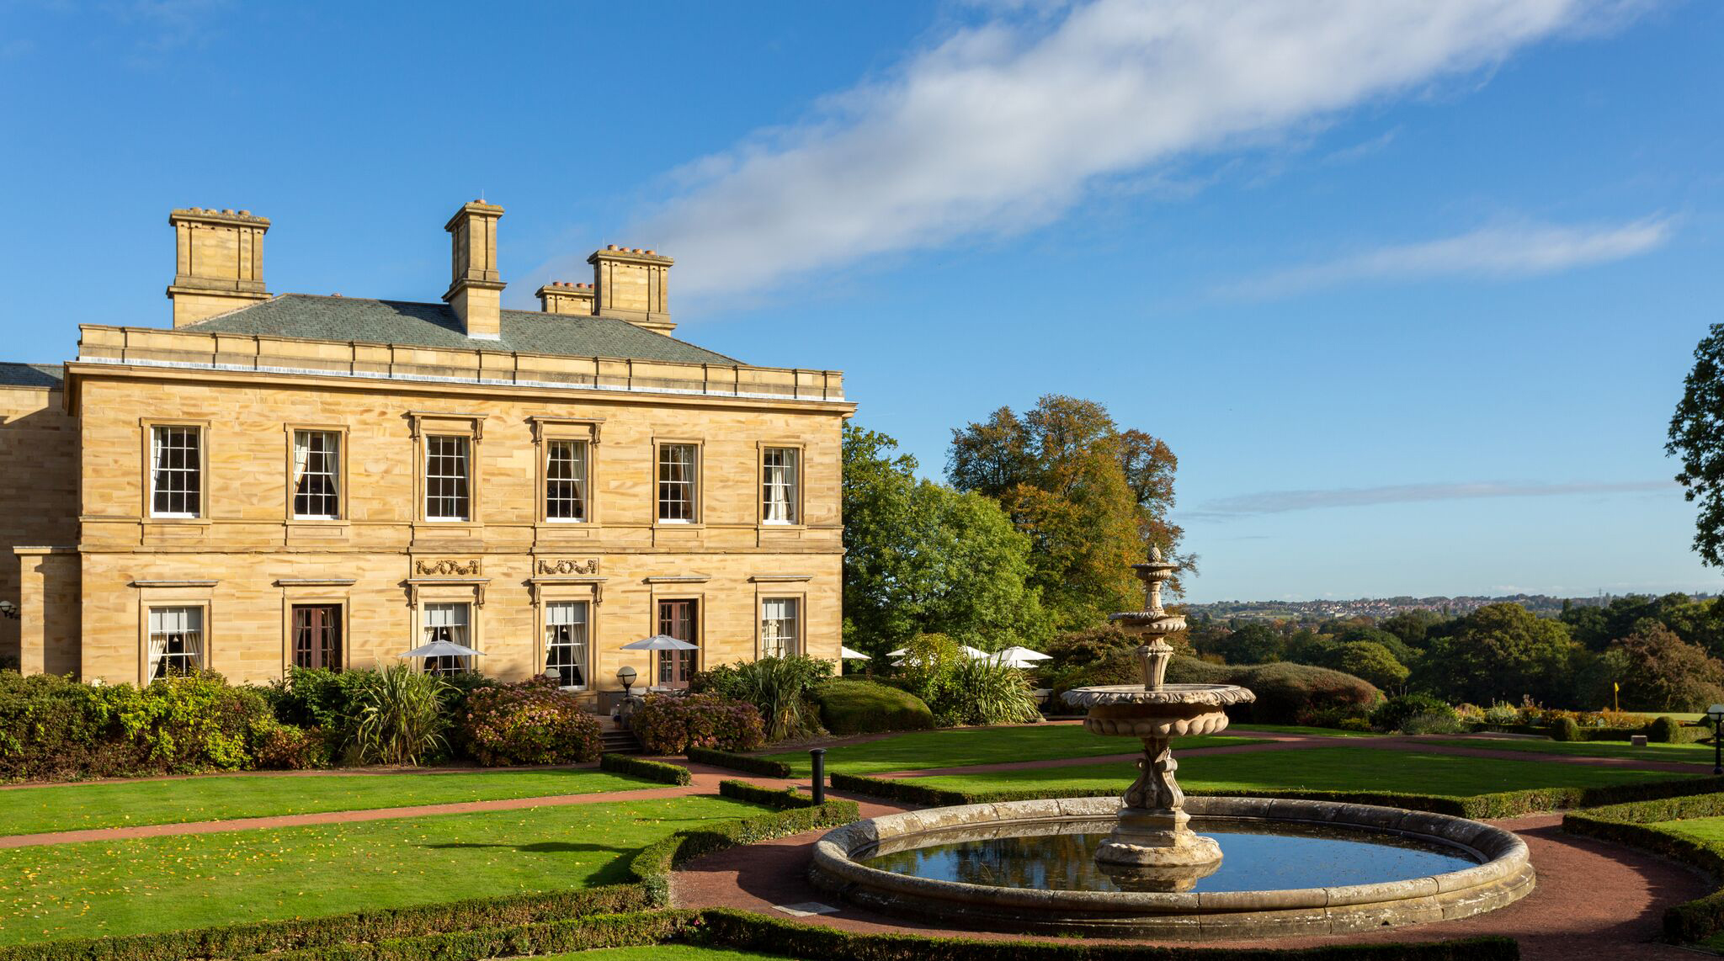


Slide 2
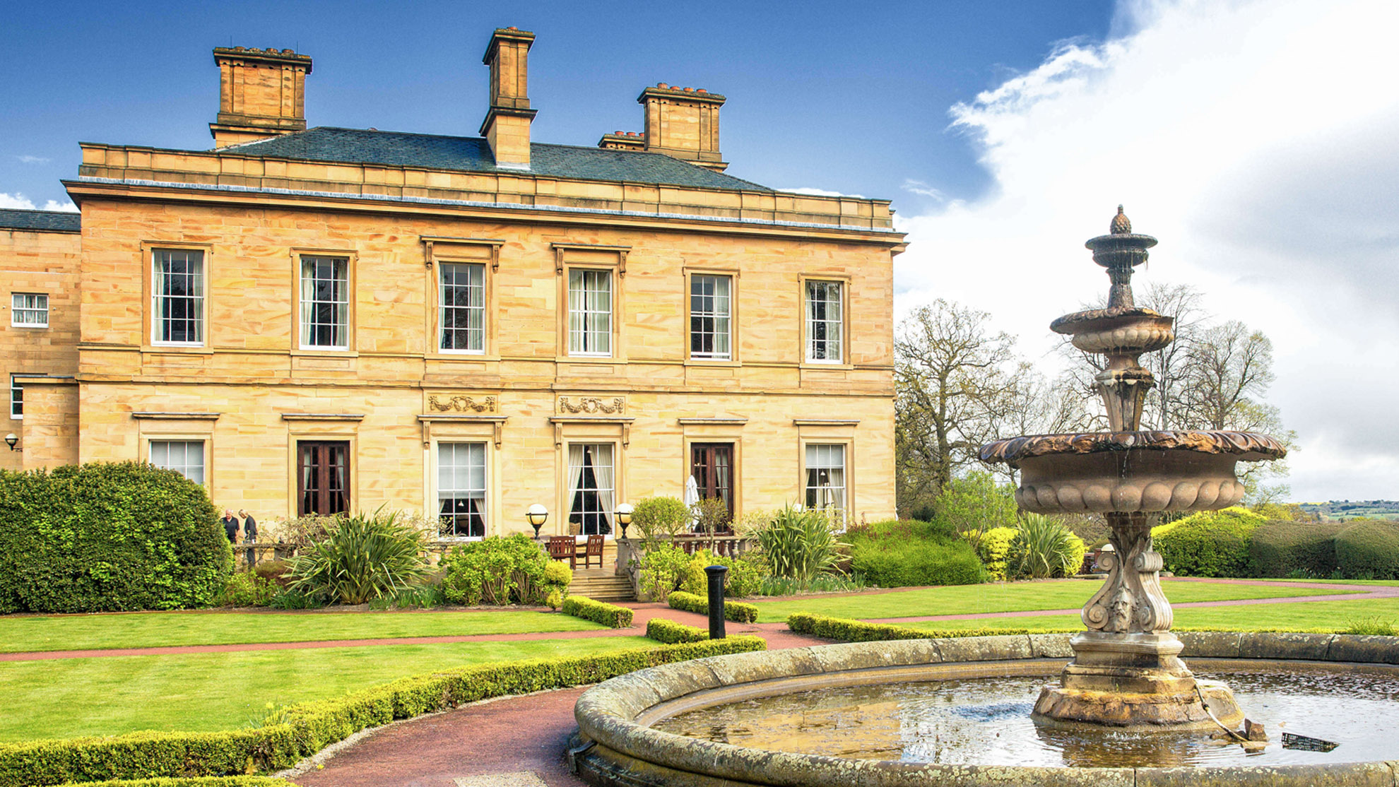
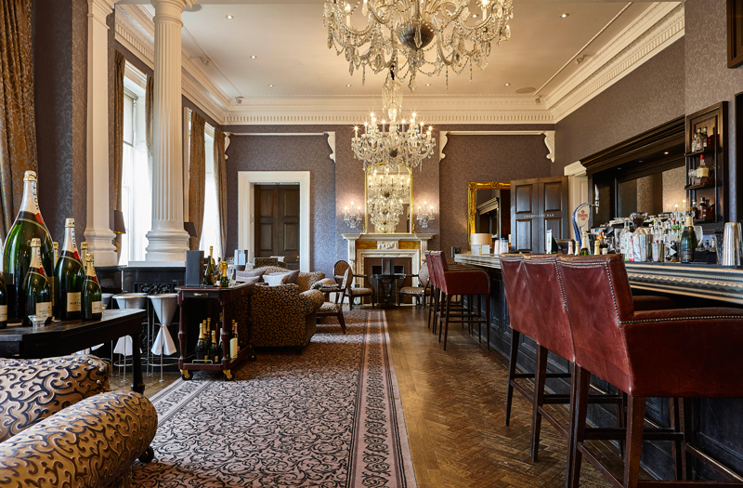
Contents
OUR LOCATION
GOLF
WELCOME TO OULTON HALL
LEISURE FACILITIES
CONFERENCES & EVENTS
DINING
BUTLER DINING
BEDROOMS
INVESTMENT

Slide 3
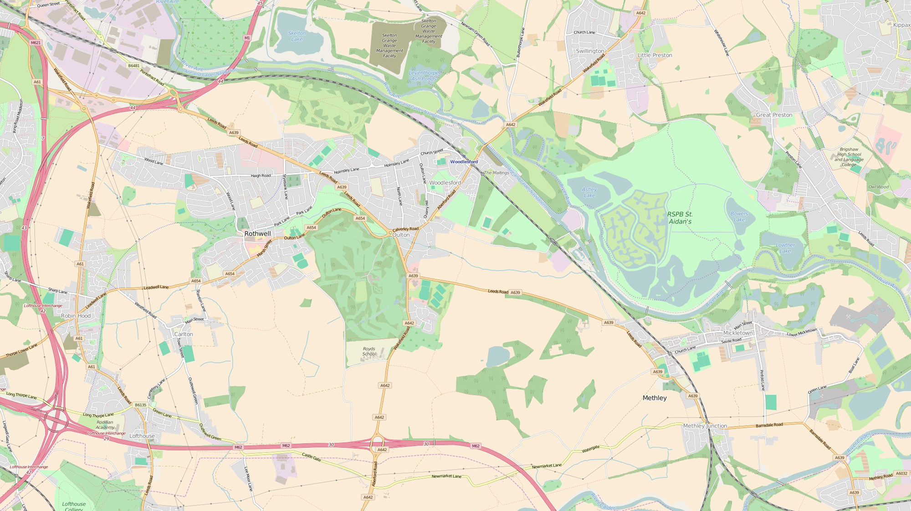

M1
A639
Location
A654
Oulton Hall
Leeds Train Station – 5 miles
Garforth Train Station – 5 miles (direct train to Manchester Int'l Airport)
Wakefield Westgate Station – 6 miles (direct train to London Kings Cross)
Leeds Bradford Airport – 15 miles
Easily accessible from M62 (Junction 30) and M1 (Junction 44)
300 free car parking spaces
A642
M62

Slide 4
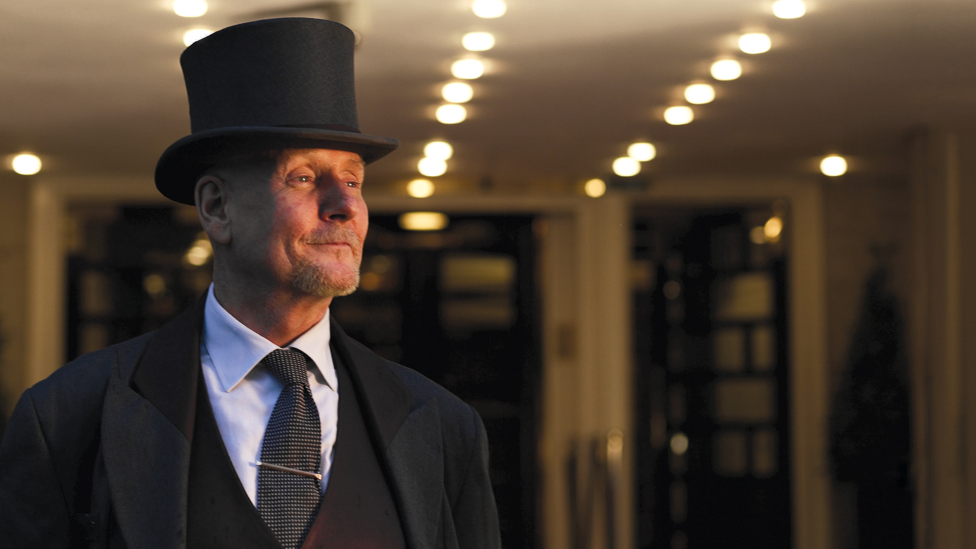


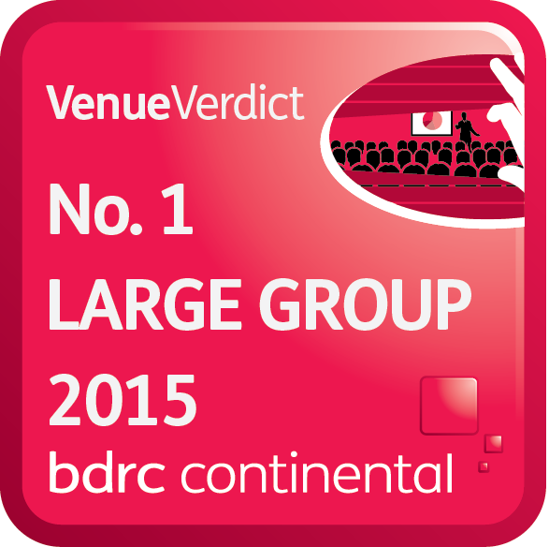
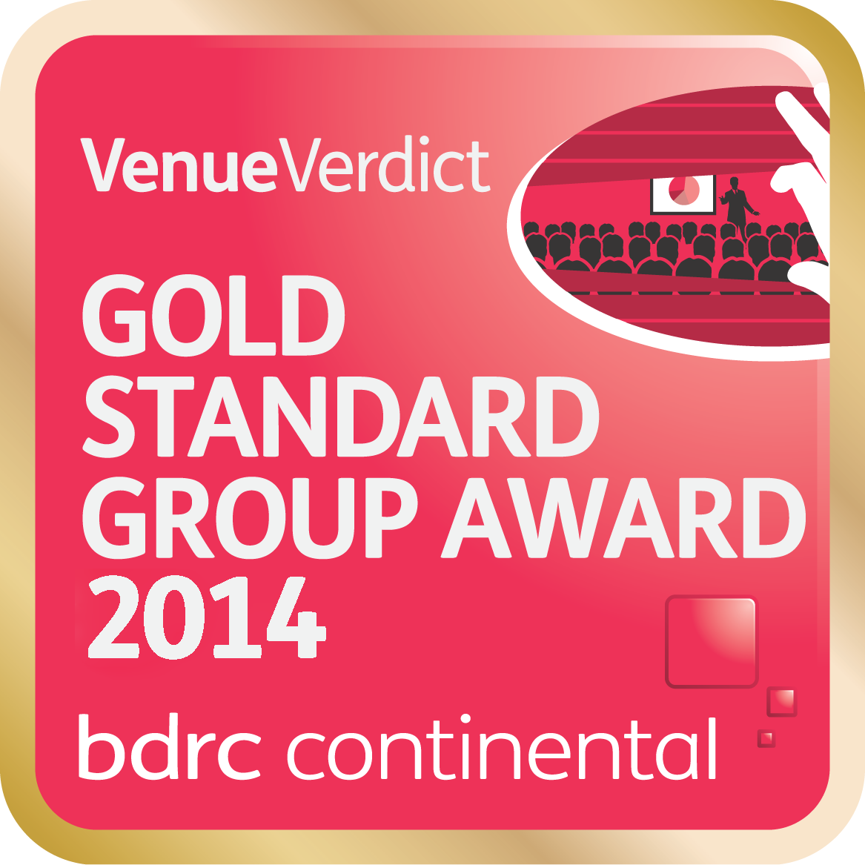

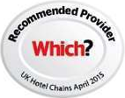

Welcome to
Intuitive Service
When you arrive at Oulton Hall you’ll be greeted warmly by our concierge.
From this moment of arrival to the moment you depart we’ll treat you like the individual you are, making sure your event with us goes perfectly in every way.

Slide 5
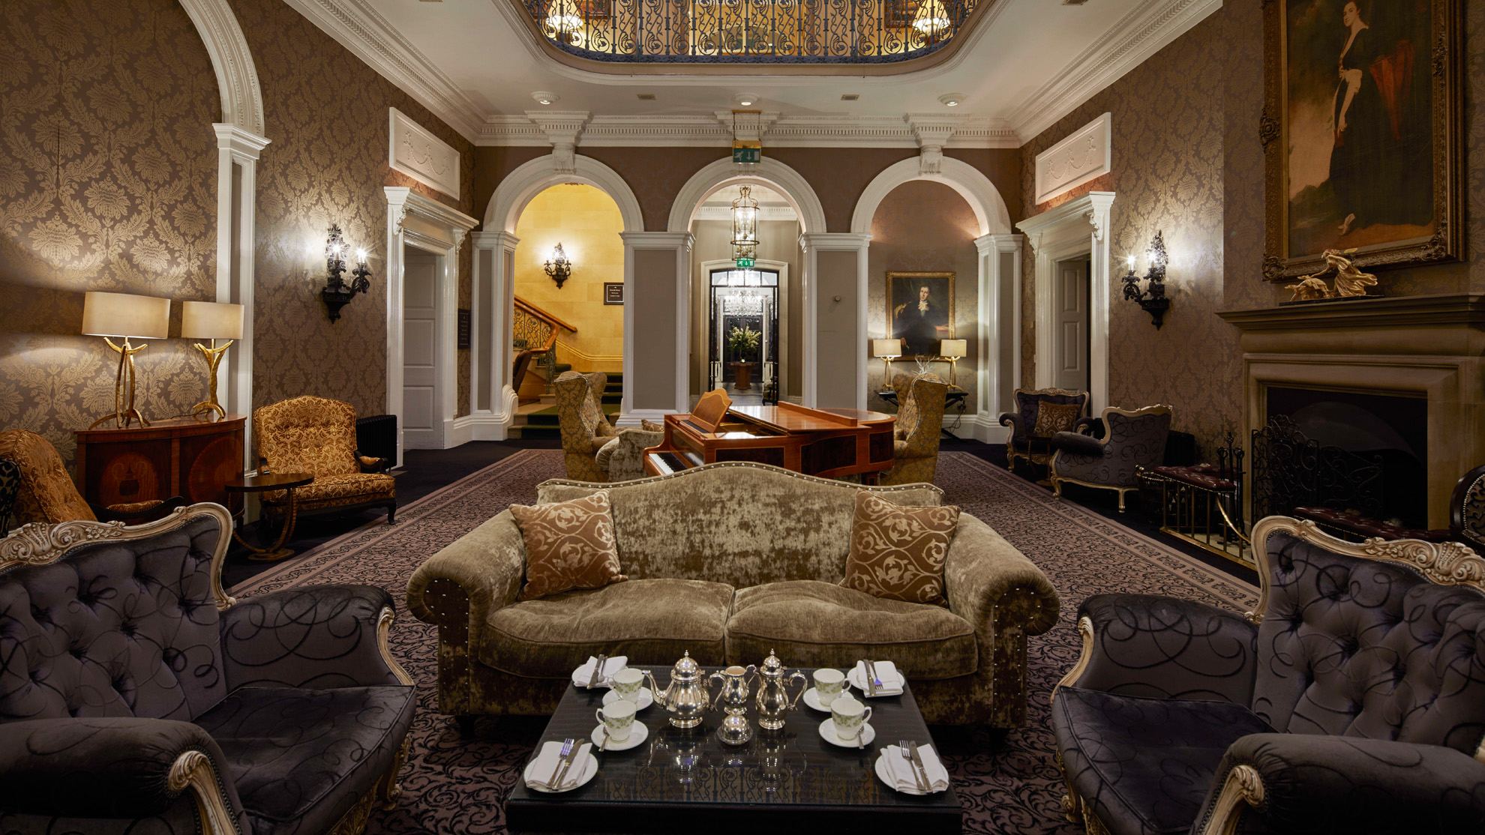
“Any request I made was met with “no problem at all; we can do that for you” which, as the organiser, is exactly what you want to hear.”
Claire Elkin
Gladstone
June 2016

Slide 6
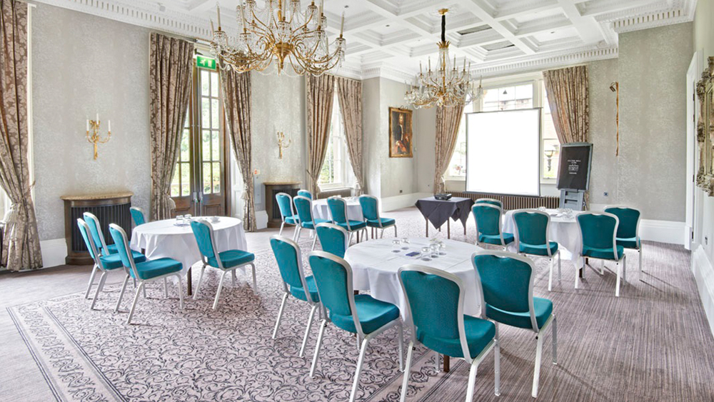
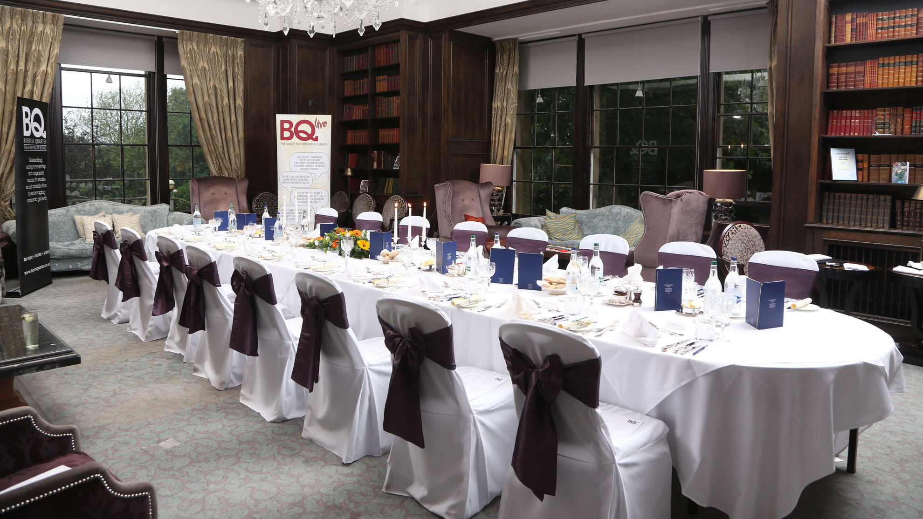
Conferences
& Events
Inspiring meeting rooms, the latest facilities and supportive and friendly service come together to create a conference venue to inspire and motivate your delegates.
Special Occasions
& Banqueting
Whether you’re planning an intimate dinner with family and friends, a cocktail party or VIP private dining, you’ll find everything is taken care of.

Slide 7
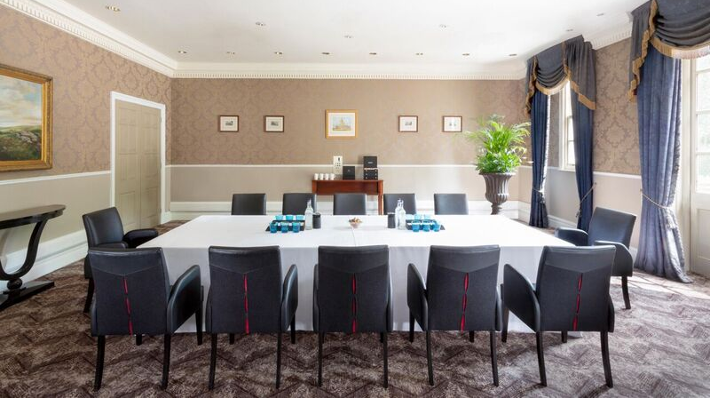
Conference &
Event Space
OULTON SUITE
CLARET JUG
REPTON ROOM
REPTON LOUNGE
ROTHWELL
PERKINS
ROSEDALE

Slide 8
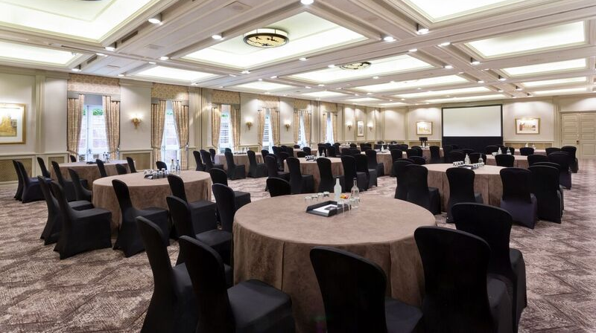


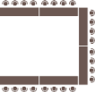


Oulton Suite
ROOM LAYOUTS
Maximum capacity of 350
CABARET
Capacity 160
Large, bright and airy suite
Private entrance, lobby and bar
Vehicular access
Room can be divided into three
smaller suites
Maximum capacity of 350
THEATRE
Capacity 350
BOARDROOM
Capacity 40
U-SHAPE
Capacity 40
CLASSROOM
Capacity 160
BANQUET
Rounds only
Capacity 250
DINNER DANCE
Rounds only
Capacity 250
Notes:
Can you pls remove reception. – done
(note to MA – when I share this with hotels need to tell them that we’ll eventually want more images showing different room layouts)

Slide 9
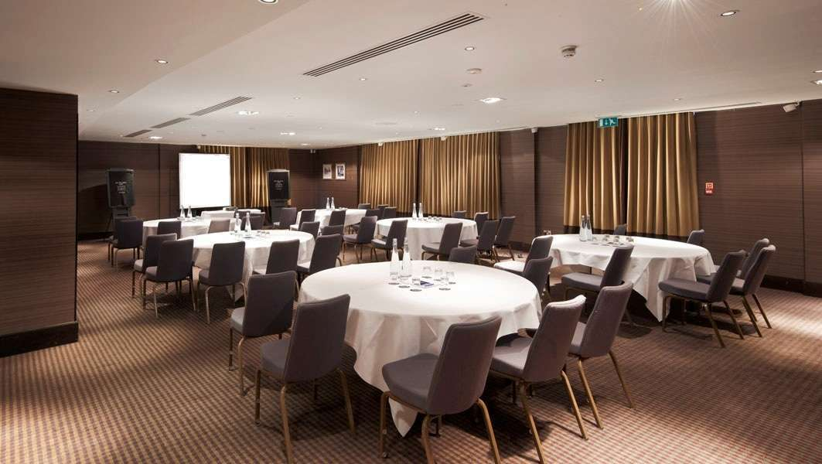
Claret Jug
ROOM LAYOUTS
Maximum capacity of 90
CABARET
Capacity 70
Stunning panoramic views of our golf course
Flooded with natural light
Self-contained facilities make it ideal when peace and seclusion are paramount
Maximum capacity of 90
THEATRE
Capacity 90
BOARDROOM
Capacity 30
U-SHAPE
Capacity 30
CLASSROOM
Capacity 30
BANQUET
Rounds only
Capacity 90
DINNER DANCE
Rounds only
Capacity 80
Notes:
Can you pls remove reception – done

Slide 10
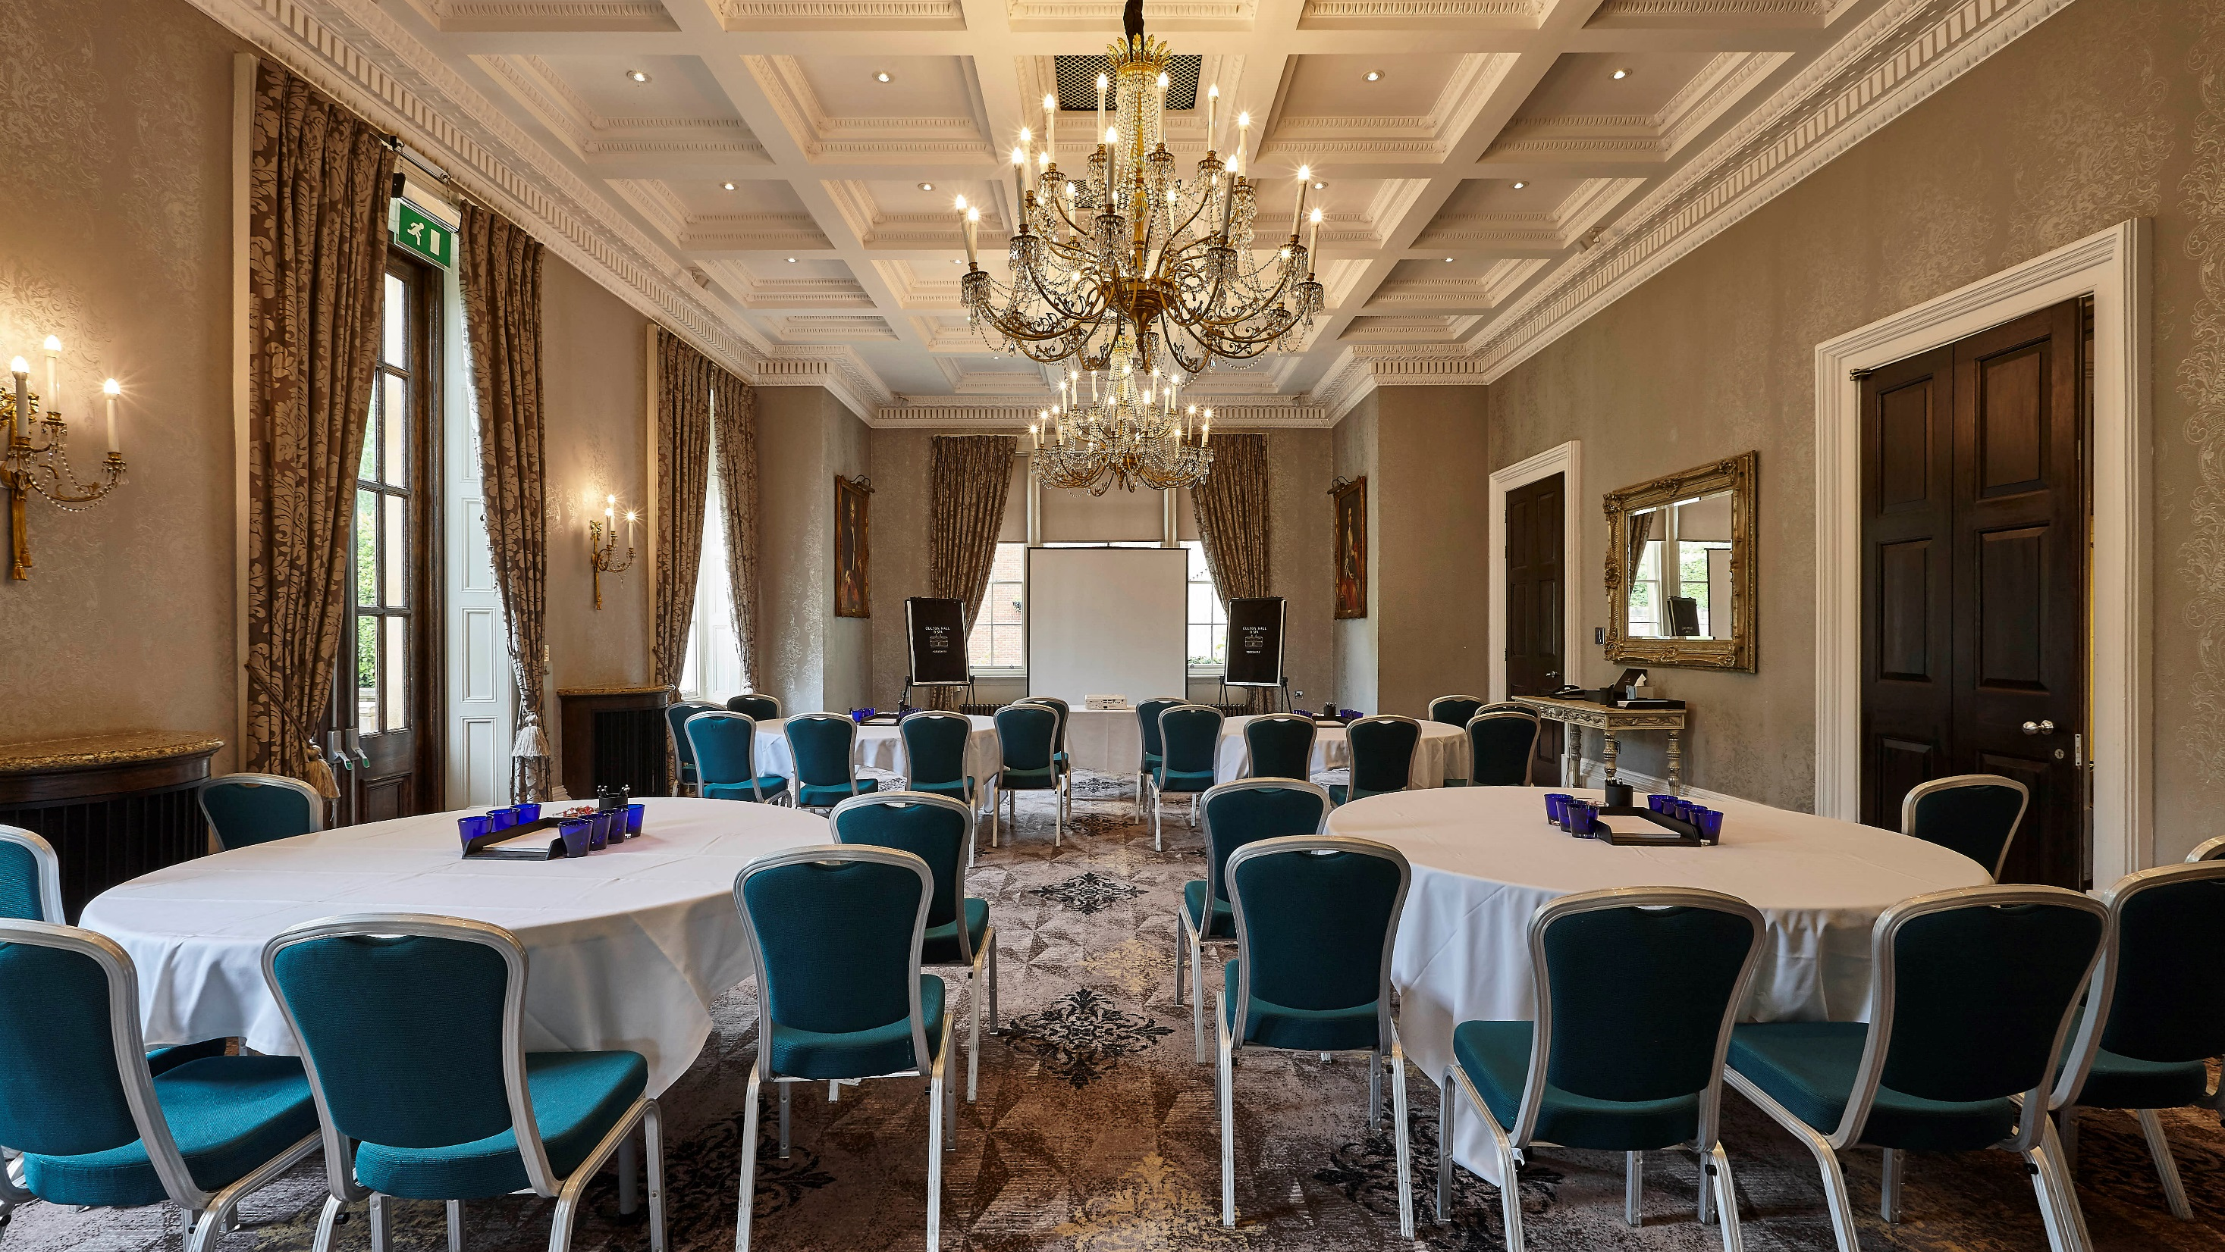
Repton Room
ROOM LAYOUTS
Maximum capacity of 70
CABARET
Capacity 35
THEATRE
Capacity 70
Situated in the original 18th century manor house
Beautiful views over the garden and fountains
Maximum capacity of 70
BOARDROOM
Capacity 24
U-SHAPE
Capacity 30
CLASSROOM
Capacity 40
BANQUET
Rounds only
Capacity 70
Notes:
Can you please remove dinner dance and reception – done

Slide 11
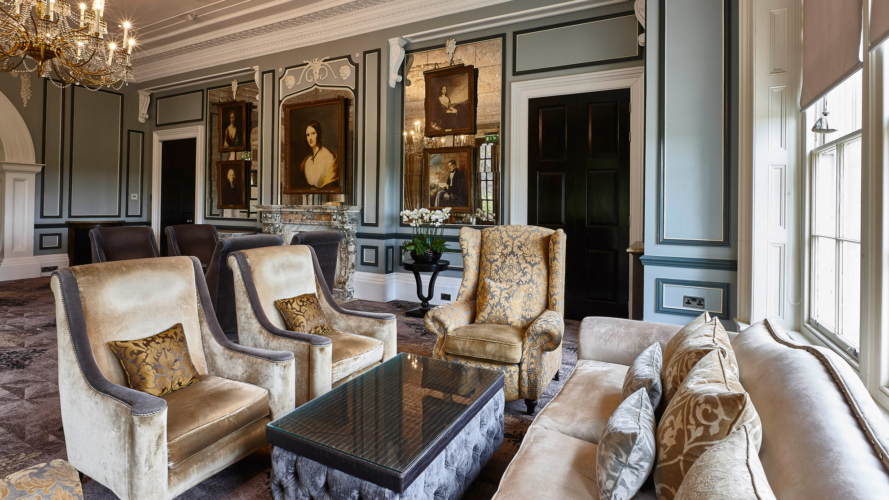

Repton
Lounge
ROOM LAYOUTS
Maximum capacity of 60
CABARET
Capacity 28
THEATRE
Capacity 35
Connected to the Repton Room
Provides the option of a comfortable breakout area or morning meeting room
Complements the Repton Room admirably for glamorous evening events
Maximum capacity of 50
BOARDROOM
Capacity 22
U-SHAPE
Capacity 15
CLASSROOM
Capacity 25
BANQUET
Rounds only
Capacity 40
DINNER DANCE
Rounds only
Capacity 40
RECEPTION
Capacity 60

Slide 12
Rothwell
Room
ROOM LAYOUTS
Maximum capacity of 50
CABARET
Capacity 28
THEATRE
Capacity 50
An ideal syndicate room or a breakout area to accompany the Oulton Suite
Also works perfectly as a small room for a private board meeting or interview.
Maximum capacity of 50
BOARDROOM
Capacity 22
U-SHAPE
Capacity 20
CLASSROOM
Capacity 30
BANQUET
Rounds only
Capacity 40
Notes:
Please remove dinner dance and reception – done

Slide 13
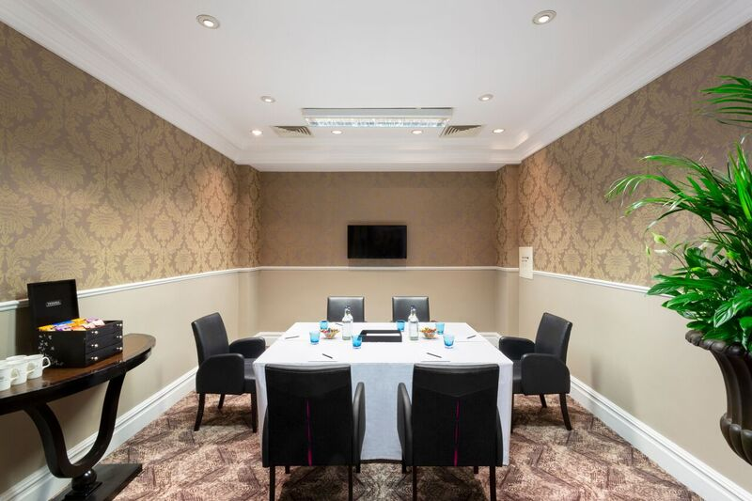
Perkins
Boardroom
ROOM LAYOUTS
Maximum capacity of 10
BOARDROOM
Capacity 10
BANQUET
Rounds only
Capacity 10
Ideal for small meetings and interviews where privacy is key
Also makes a perfect conference hub
Maximum capacity of 10
Notes:
Please remove all layouts except boardroom and banquet. – done

Slide 14
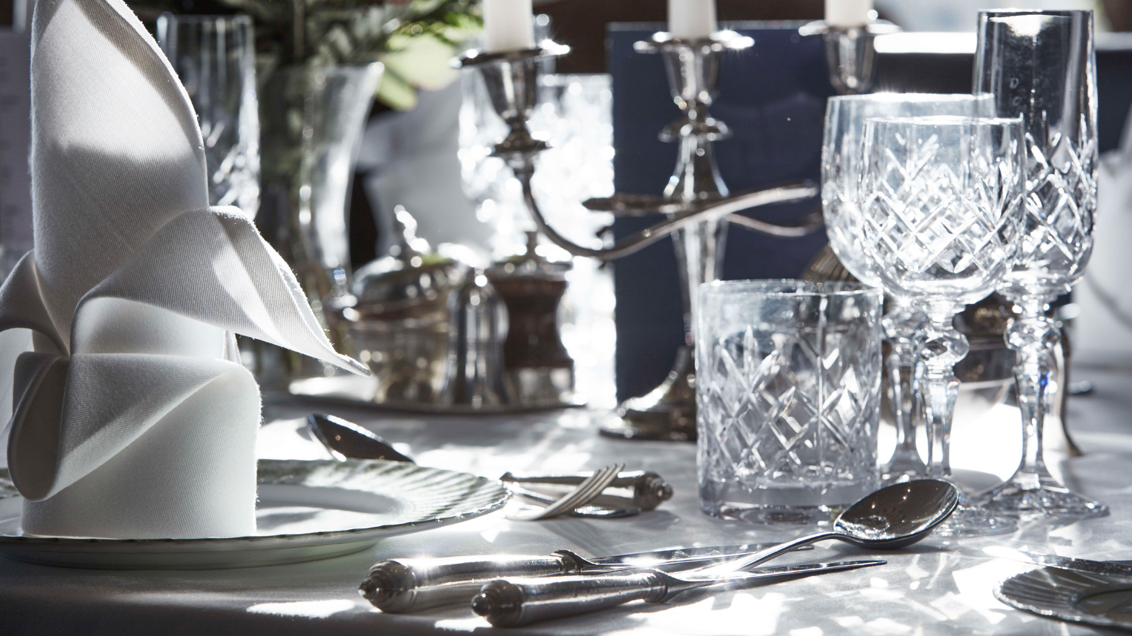
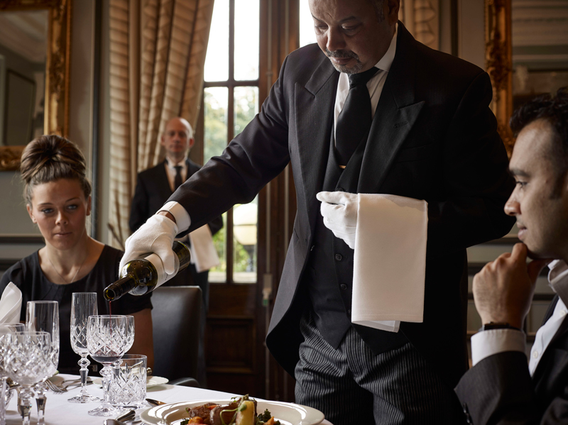
Butler Dining
At Oulton Hall we strive to create the perfect dining experience, ideal for directors’ dinners or an exclusive evening for your most prestigious clients.
Our butler dining adds an air of exclusivity and uniqueness to your event, ensuring you and your guests are relaxed and your every need
is catered for.

Slide 15
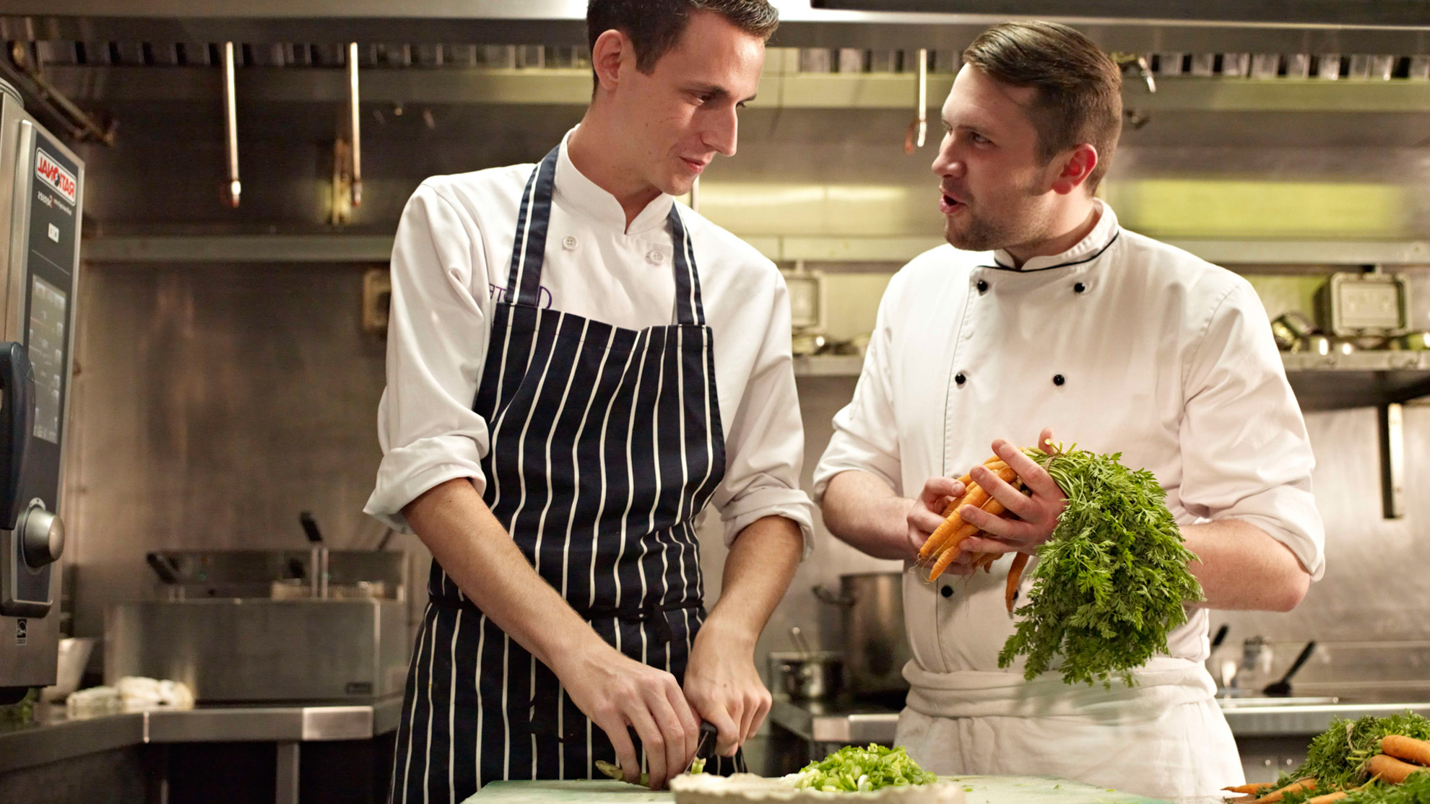
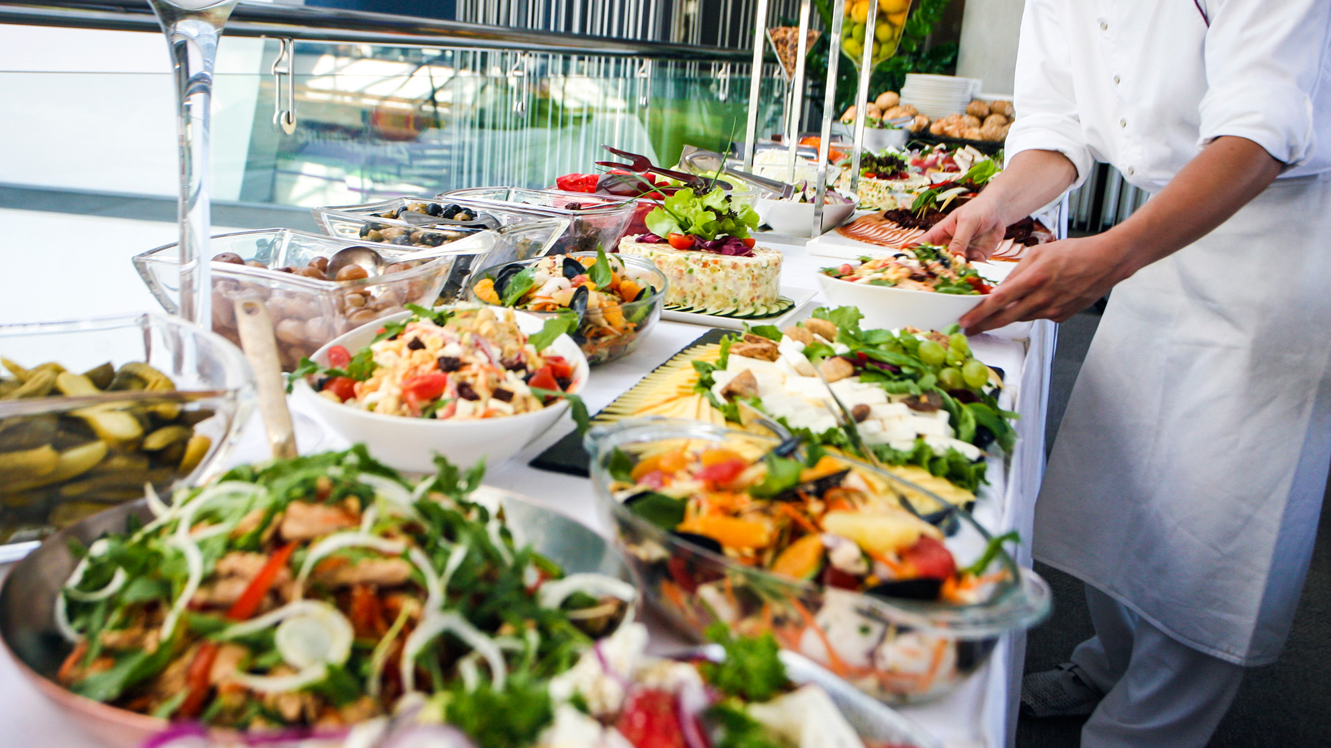
Conference
Dining
We’re committed to helping your delegates maintain their energy levels and concentration through the day with our range of nutritional menu options including:
Themed dining
Buffet or working lunch
Our innovative Brainfood menu
Special dietary requirements catered for

Slide 16
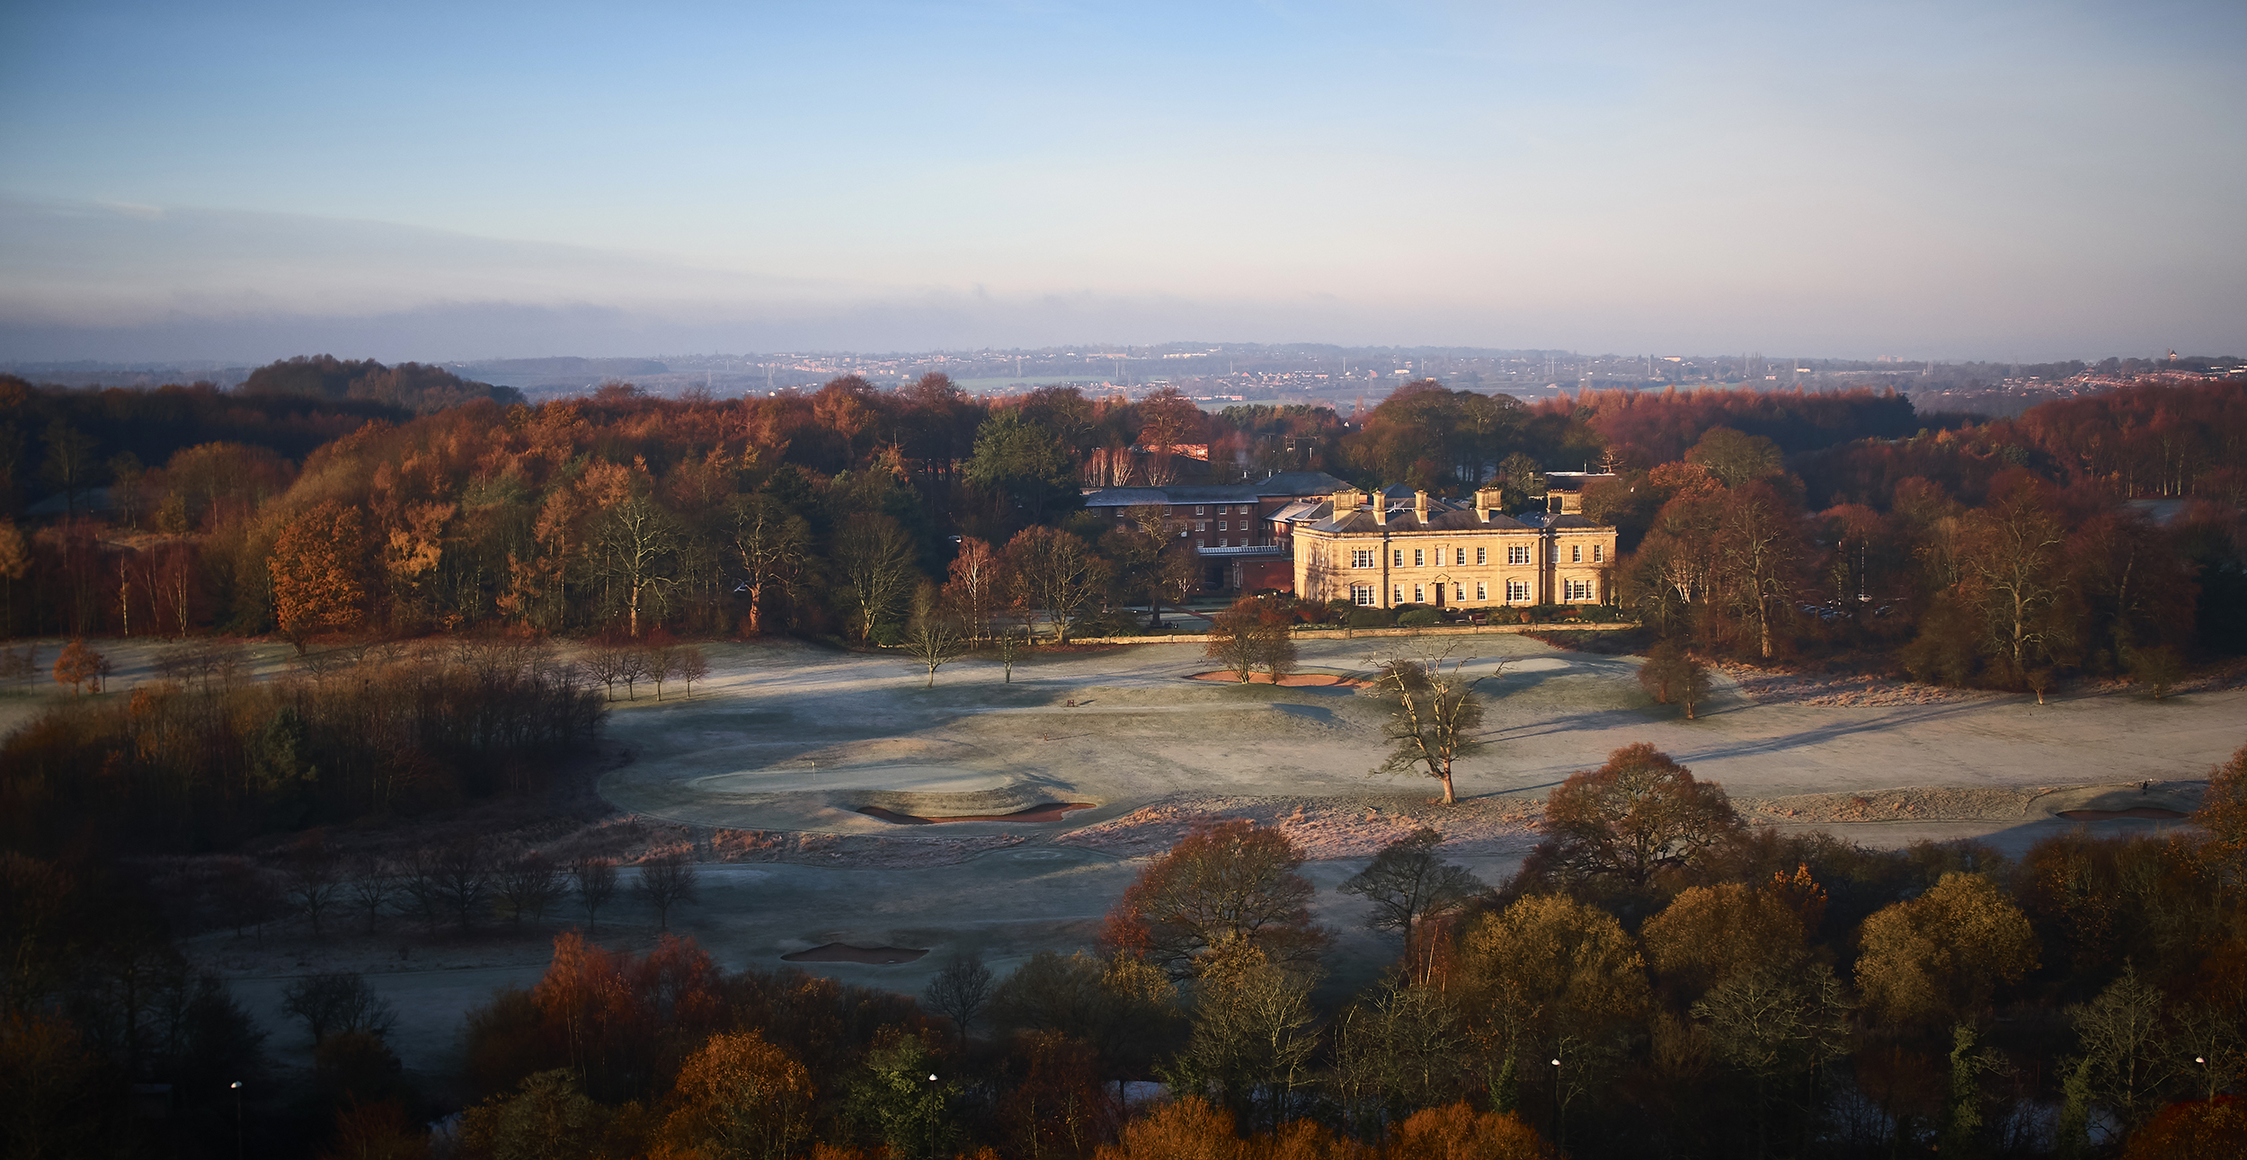
£1m Investment
£1,000,000 has been spent at Oulton Hall in 2016, including:
Completely refurbishing 72 bedrooms and bathrooms
Extensive bedroom corridor redecoration
Laying premium quality carpets throughout conference and events areas
Upgrading Wi-Fi throughout the hotel so it’s now fast, easy and free.

Slide 17
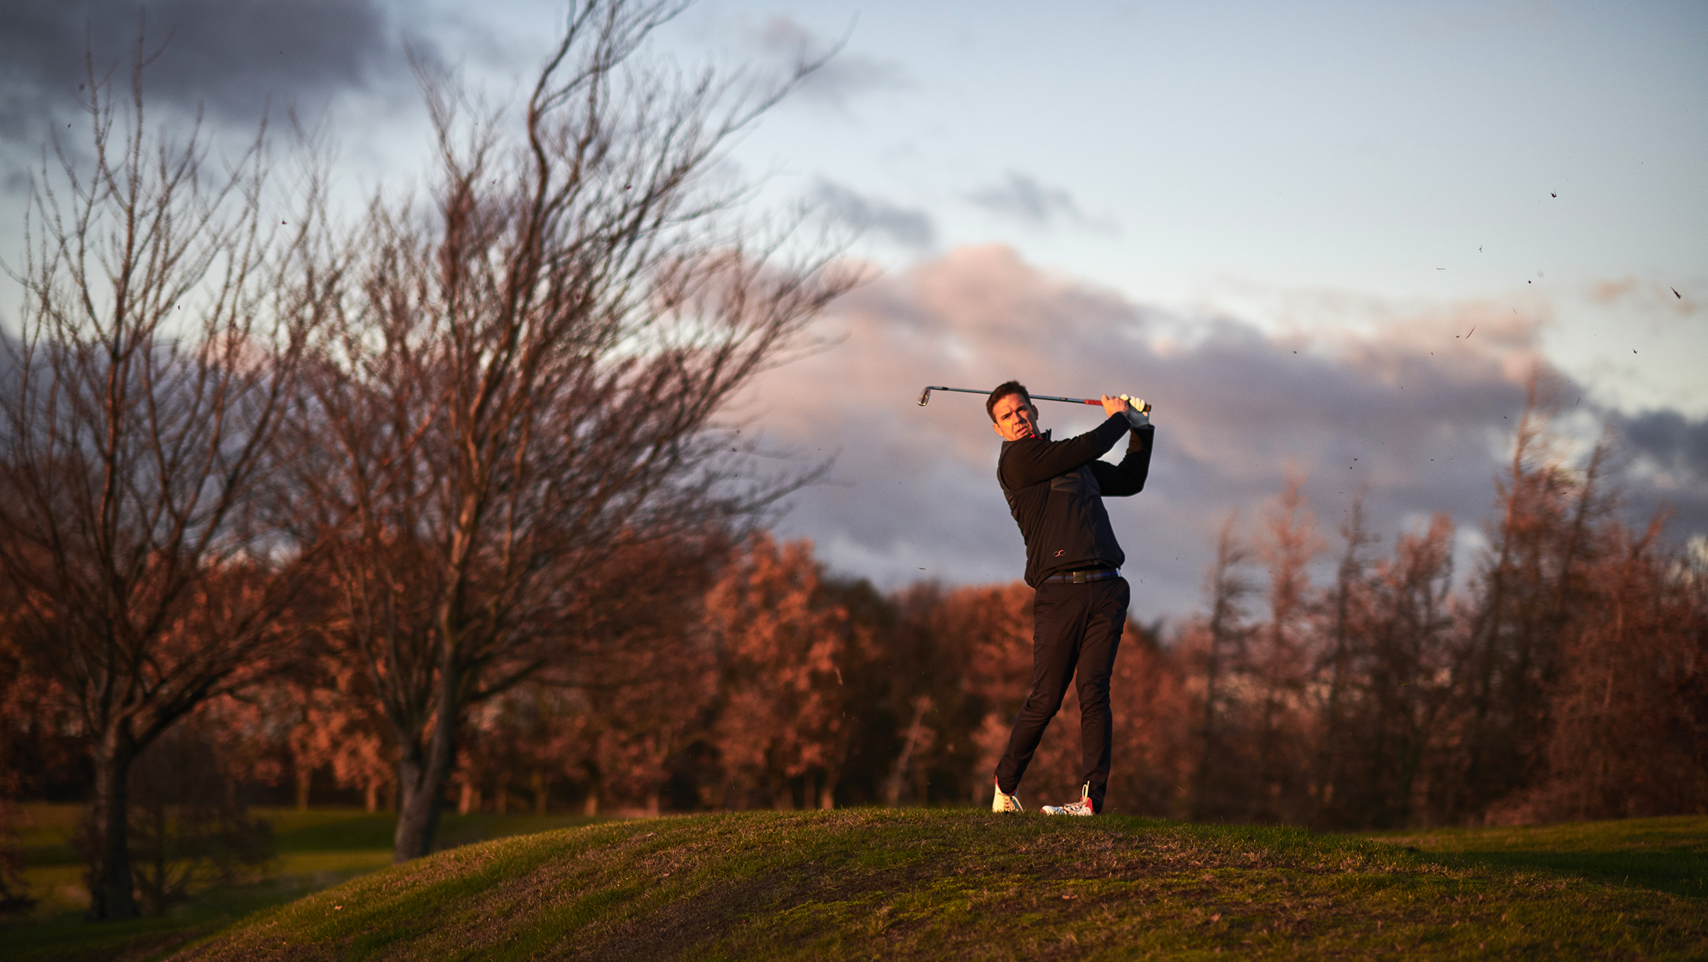

Set amongst 320 acres of stunning Yorkshire parkland, the meandering fairways and perfect greens of the Calverley course and the picturesque par 36 Hall course are a good test for golfers of all abilities.
We offer:
Packages for residential golf groups
Corporate or society golf days
The option to raise your game with our PGA Academy
Fairway corporate membership
Notes:
To explain QFairway? URL to go in to notes?

Slide 18
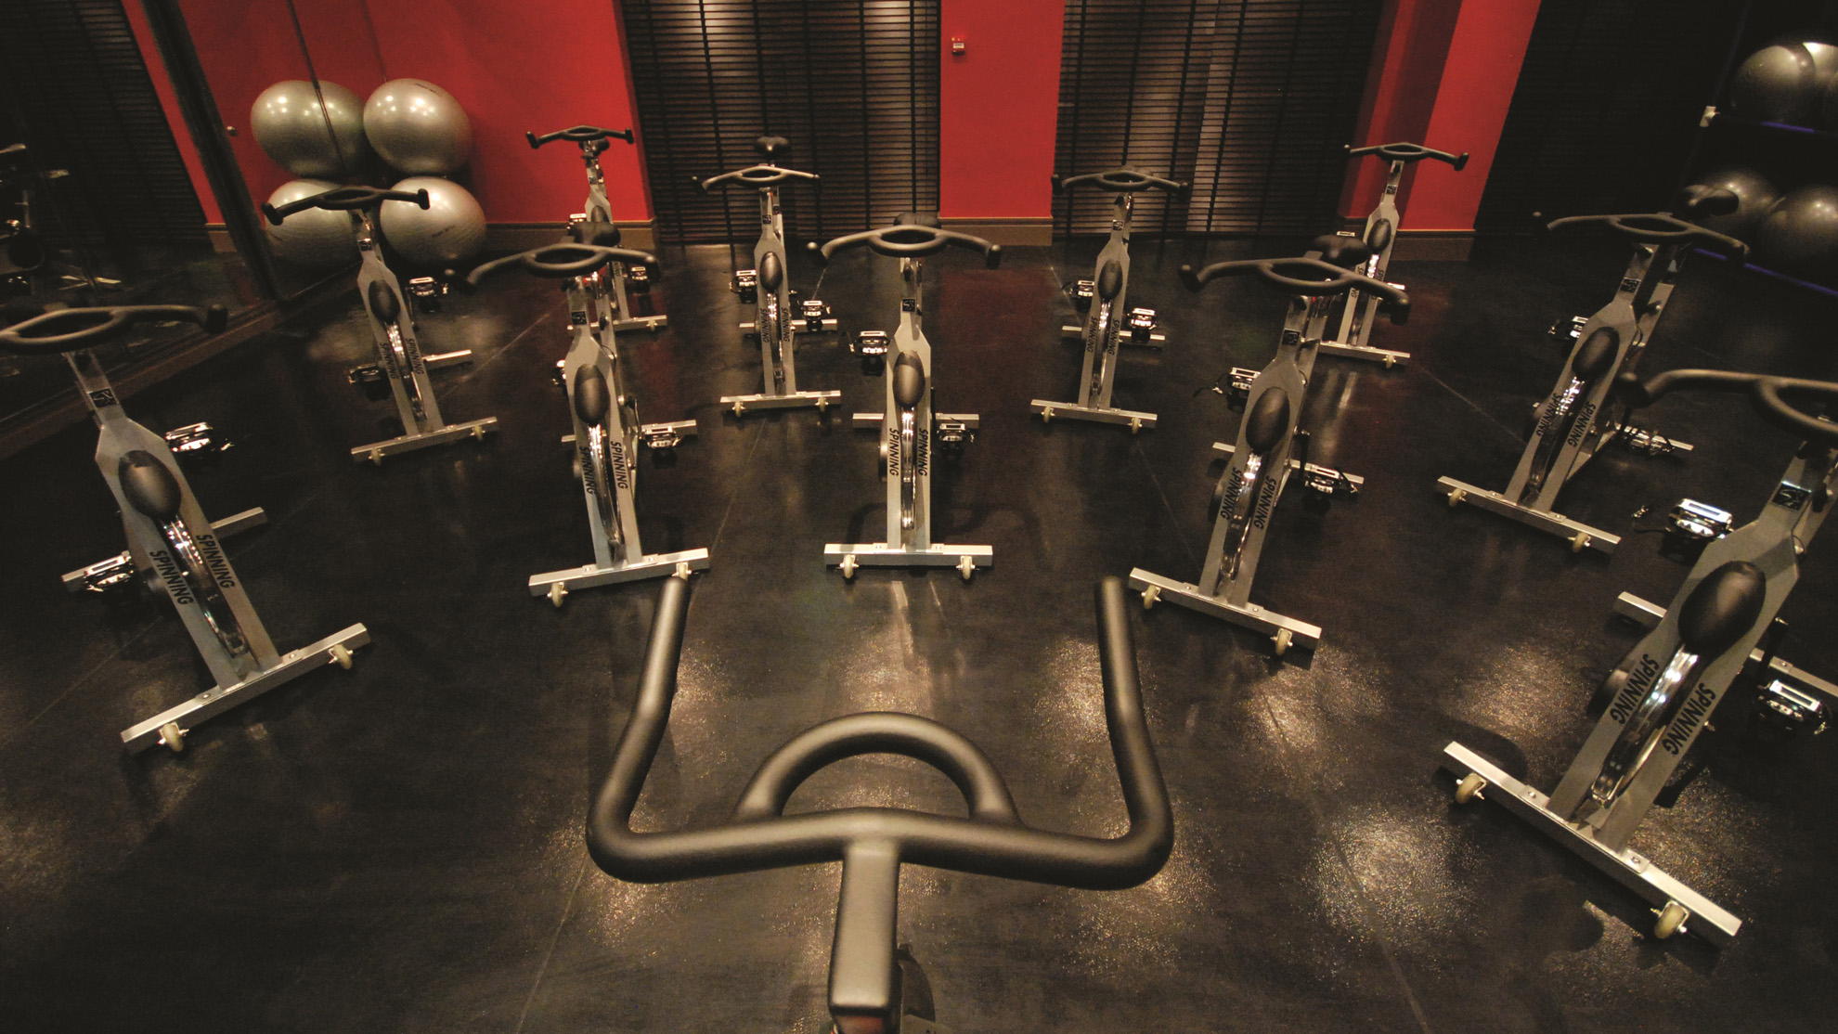
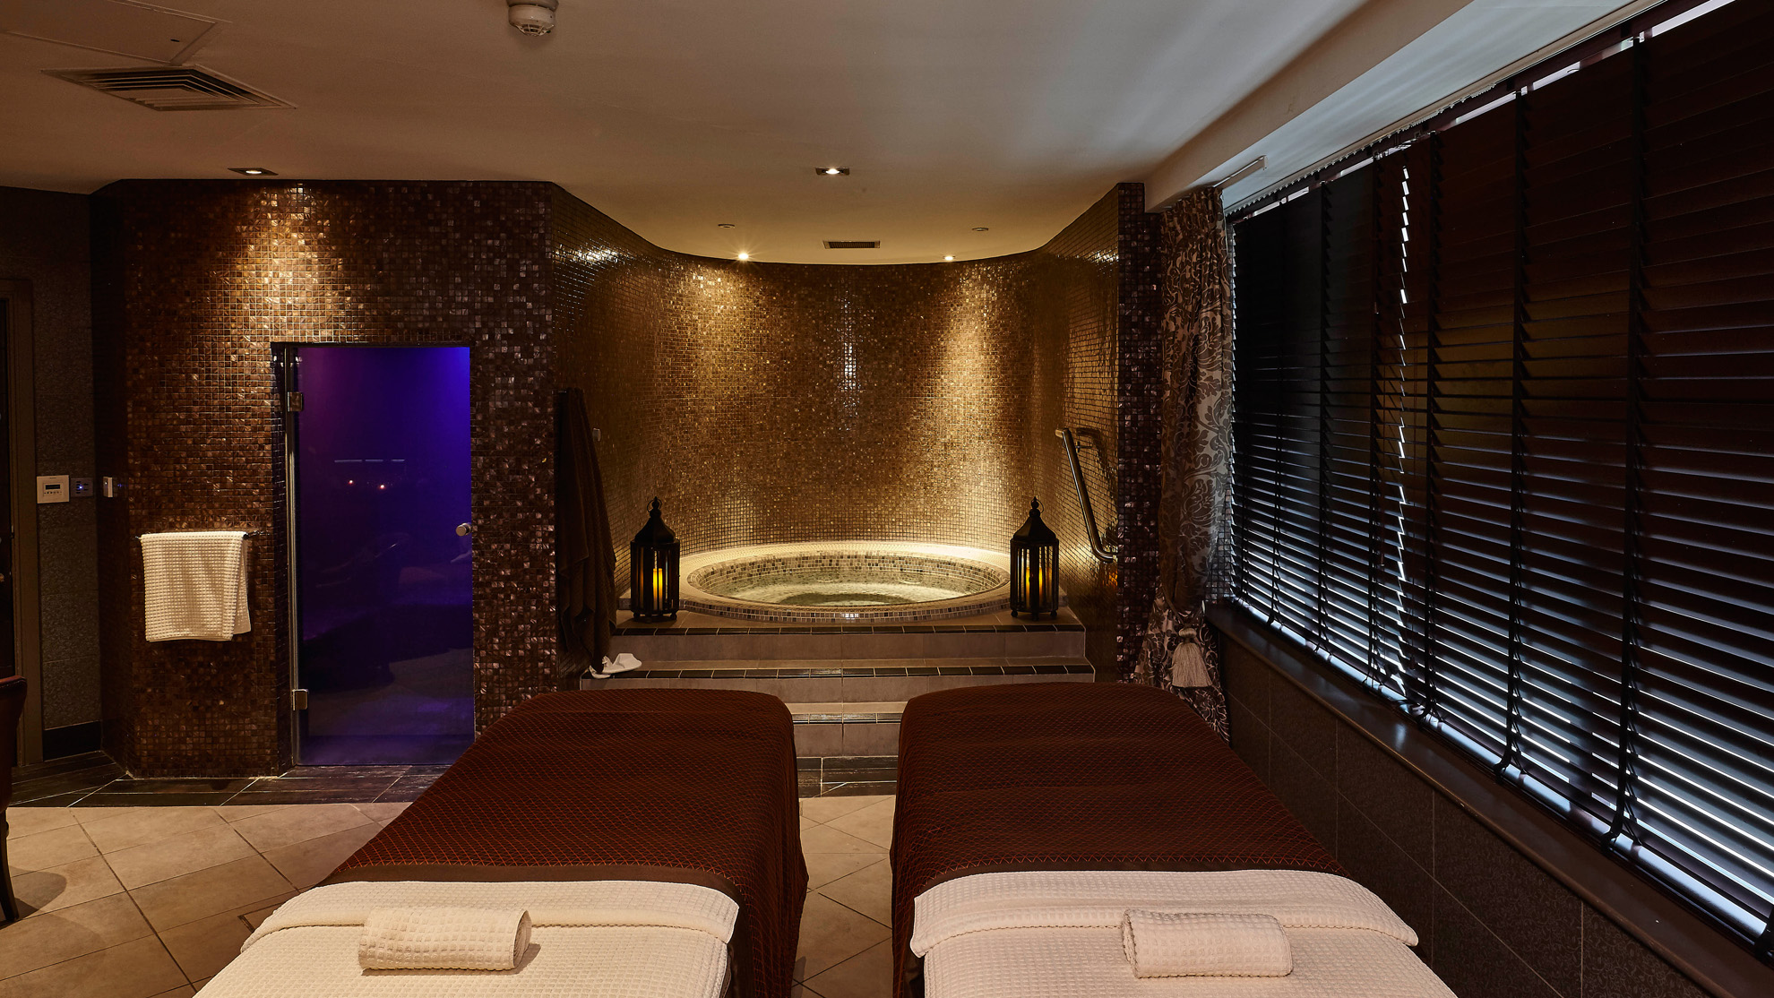
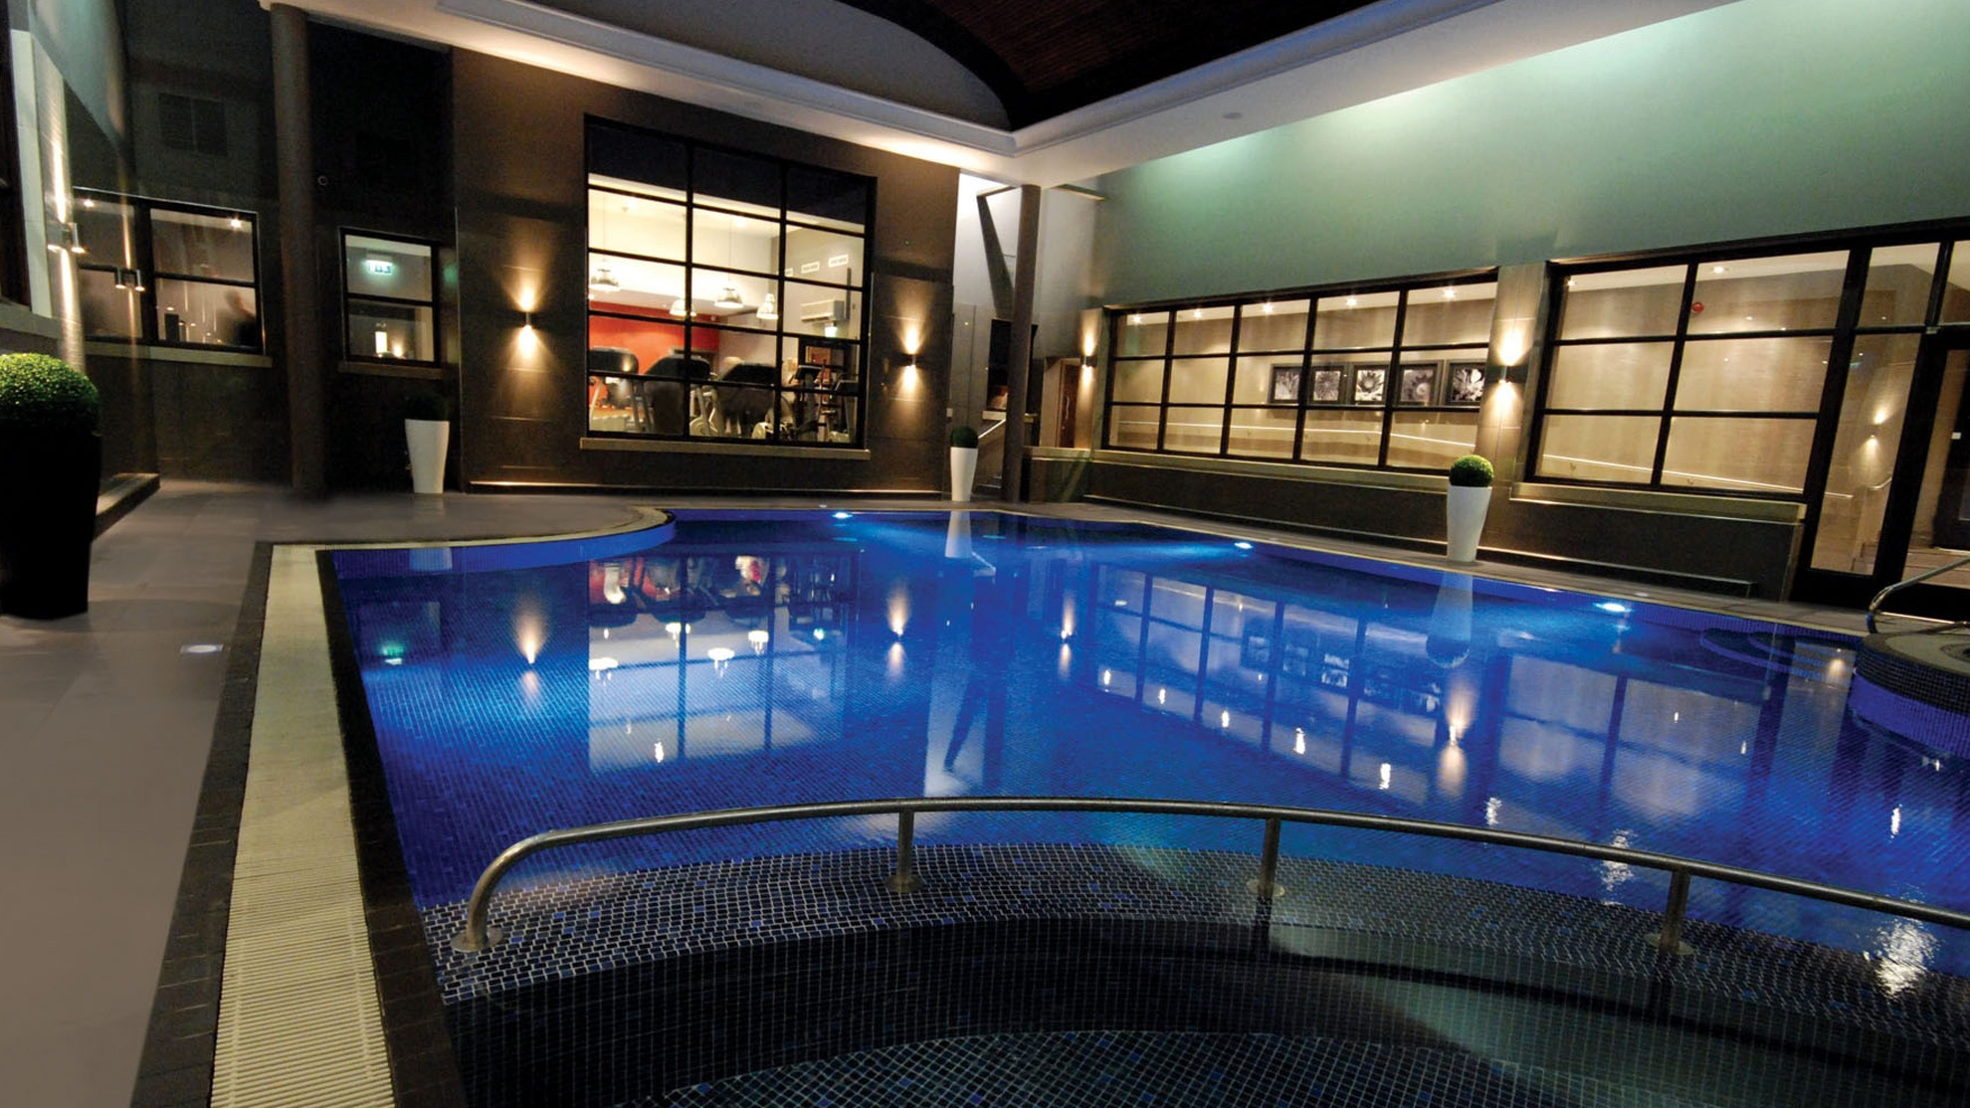
Spa & Leisure
Facilities
Swimming pool
Whirlpool, sauna and steam room
Fully equipped Technogym and
air-conditioned studio
Luxurious spa offering a wide range
of treatments
Spa exclusive use
available

Slide 19
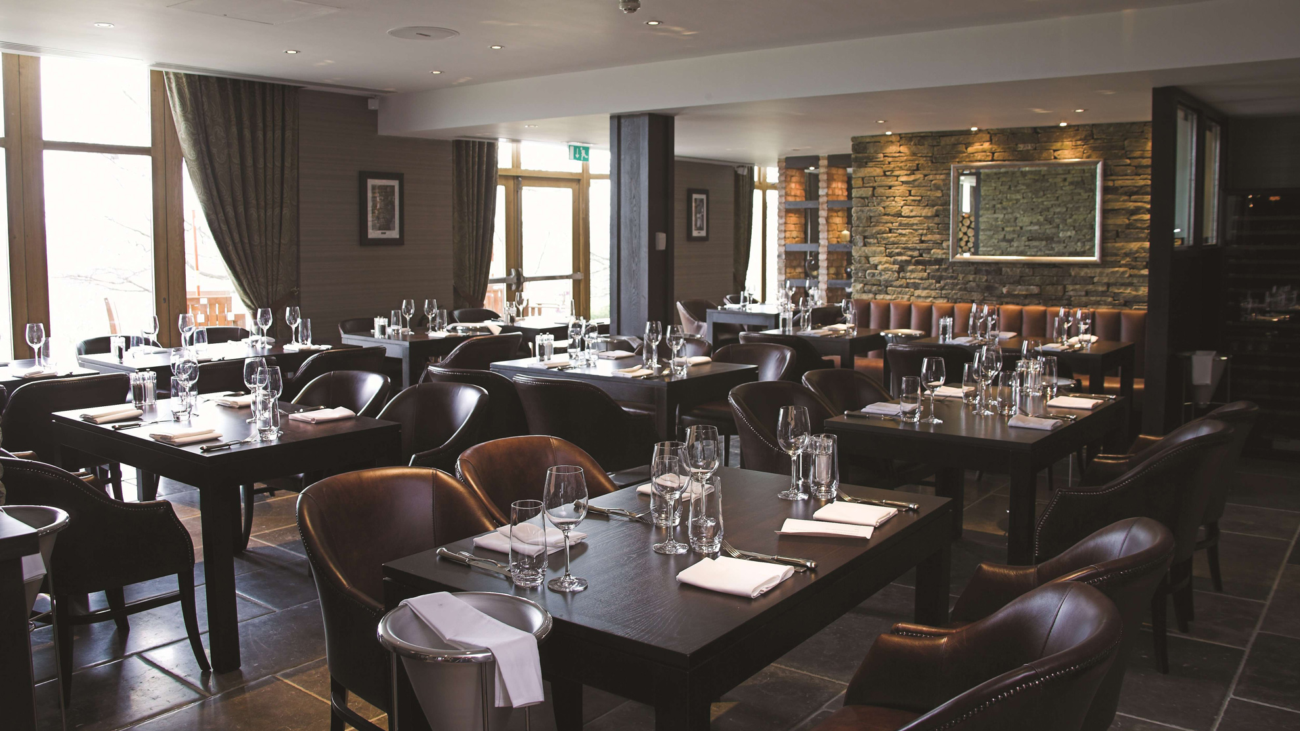

Dining
Classic British dining with a contemporary twist, using local produce
Two restaurants on site: Calverley Grill
and the Claret Jug
Renowned for supreme Afternoon Tea
& a glamorous Champagne Bar
Butler Dining available as
an exclusive treat

Slide 20
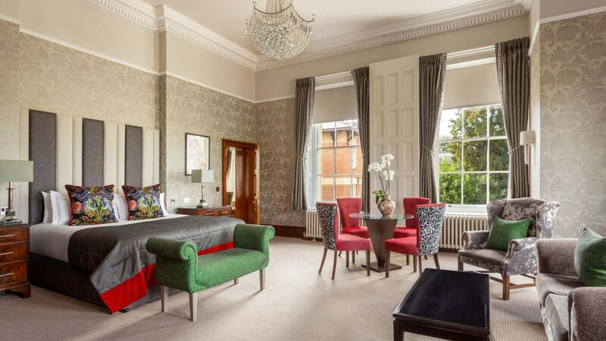
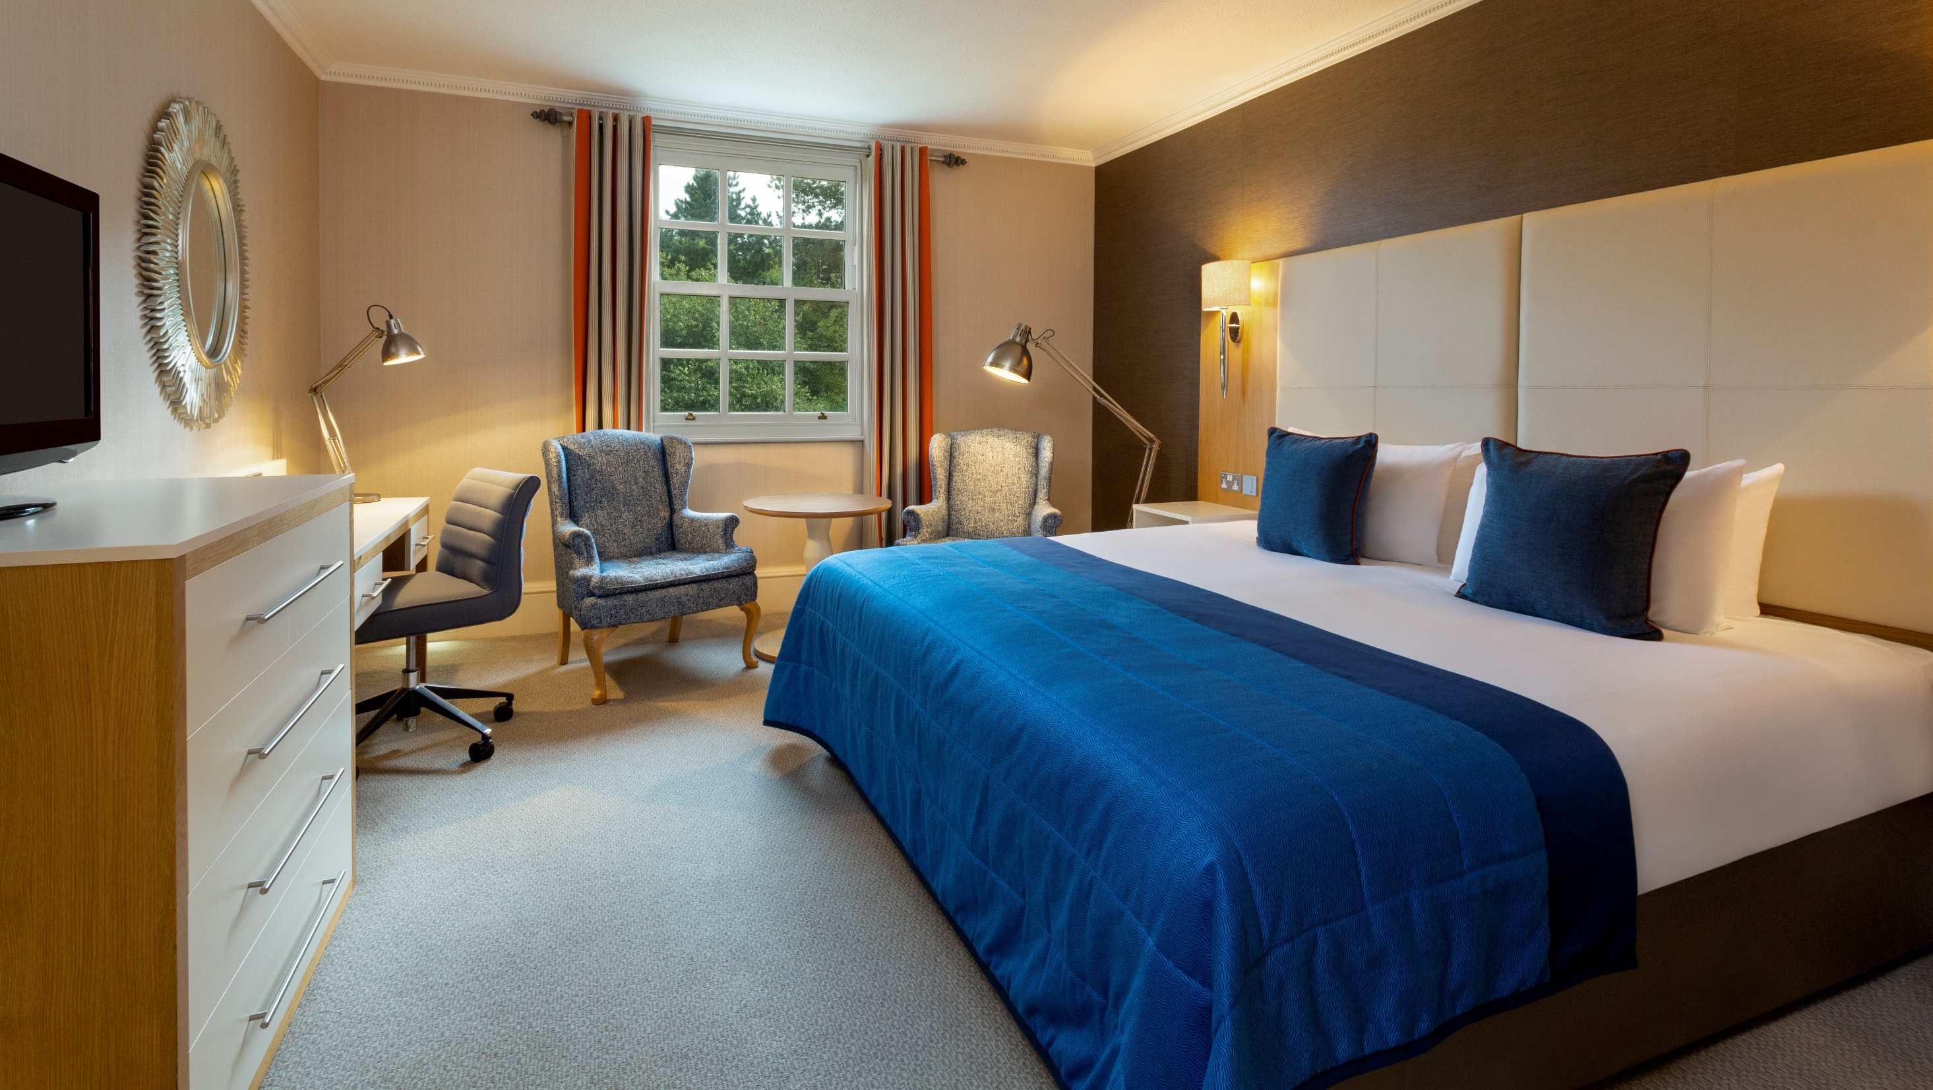
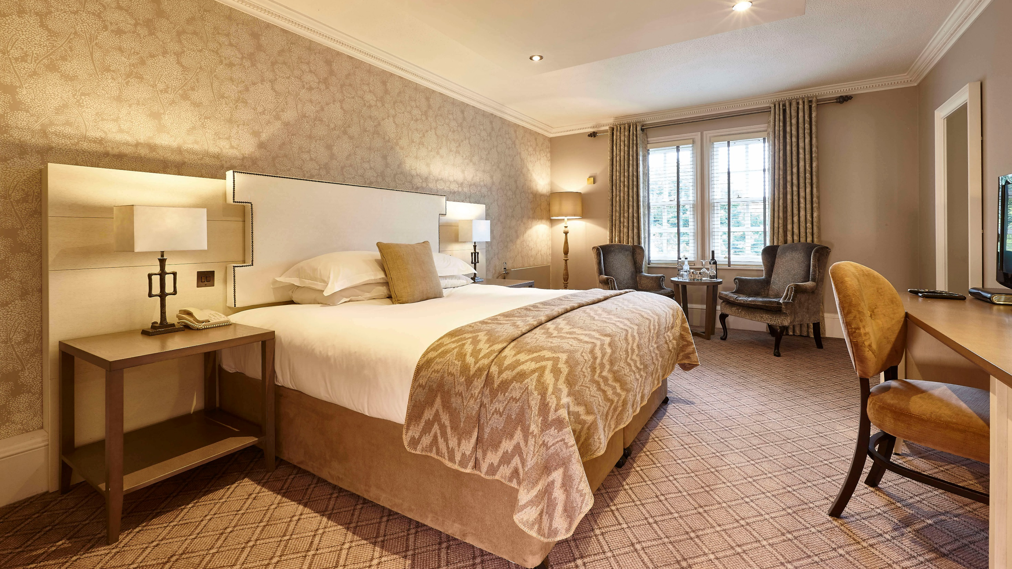
Bedrooms
152 bedrooms, many refurbished in 2016
Luxurious beds, sumptuous bed linen and elegant décor
Try our VIQ rooms or suites for the highest levels of comfort and
grandeur

Slide 21
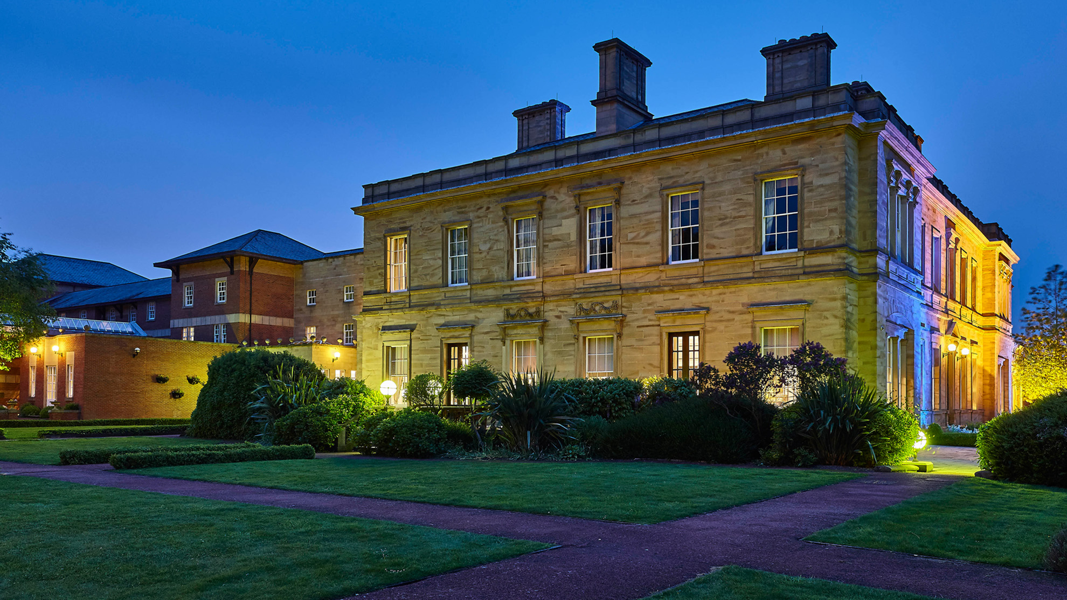
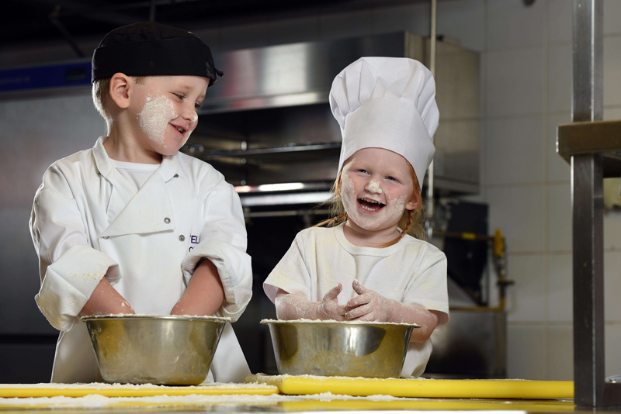
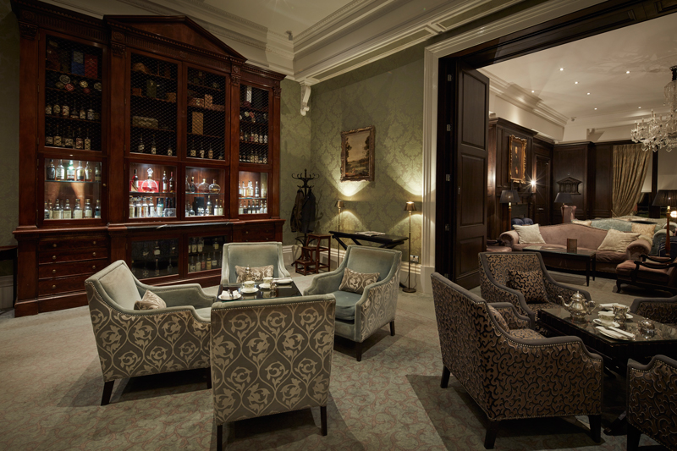
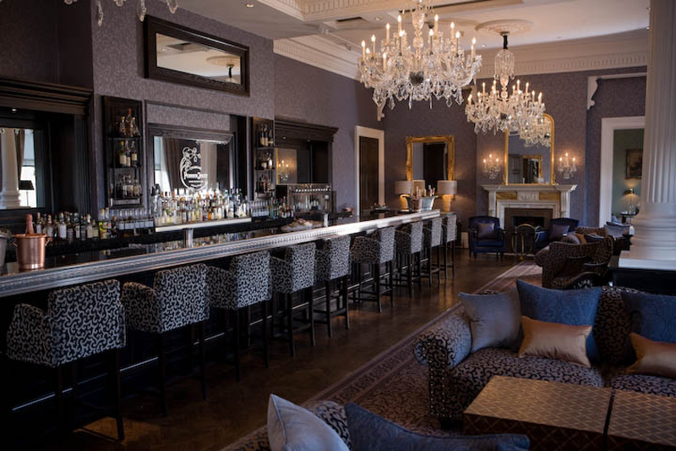
Proud to support NSPCC

